Slide 1
Asking for more
Creating natural opportunities for your child to learn how to appropriately ask for more (food, toys, attention, etc.)

Slide 2
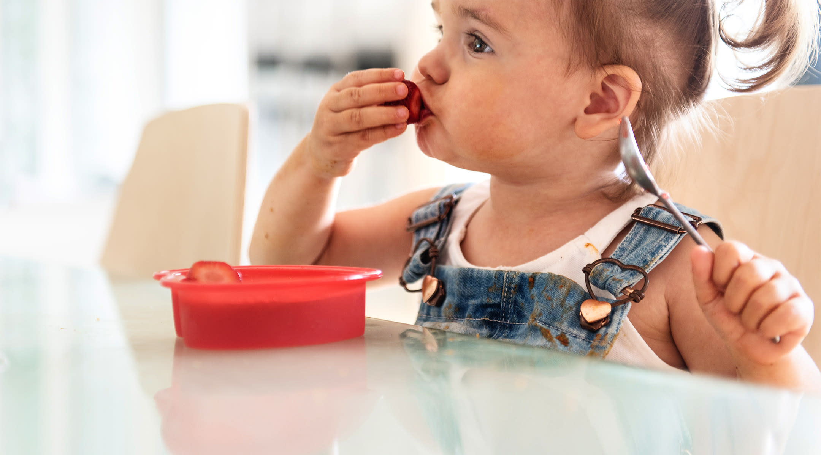
Step 1
Your child is given a small amount of a preferred item, a piece of fruit or a few goldfish crackers for example.
In this example it is a snack but this same strategy could be applied to toys (such as bubbles), or attention (like tickles).

Slide 3
Step 2
The child eats piece of strawberry. You can ask the child, “What do you need?”
Although it’s understood that the child wants more of the snack, toy, or attention, it’s important that we provide opportunities for them to practice vocalizing so that they can learn to advocate for themselves.

Slide 4
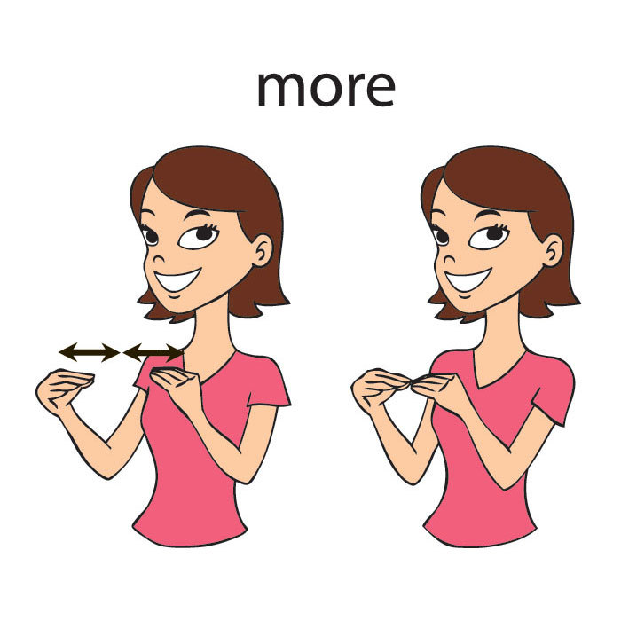
Step 3
The child asks for more.
If your child is vocal, it’s preferred that you have them use specific item names to request. and depending on how vocal they are, they can say a variety of phrases.
For Example:
“strawberry”, “strawberry please”, “more strawberries please”, or “I want more strawberries please.”
If your child is not vocal, they can gesture (Use the American Sign Language sign for more) or use visuals to ask for more (have a picture of the snack that they can hand to you).

Slide 5
Step 4
“More”
If your child can not yet independently ask for more, here is some steps you can take to help them learn, called prompting.
Prompting your child to ask for more.
Vocal
Non-Vocal
gestures
Model the desired phrase and have the student repeat you. If the desired phrase is “strawberry” then that is what you say and they should repeat.
Model the gesture to indicate that she or he wants a turn (see image on last slide).
If your child will not imitate the action independently , gently take their hands and help them to do the gesture while you say "More", fading out the support over time (see next slide for example)
(example:
You say Strawberry --> Child says Strawberry.
You say More strawb..- --> Child says Strawberry.
You say Straw.. --> Child says Strawberry.
You say /s/ --> Child says Strawberry.
No prompt --> Child says Strawberry.

Slide 6
Non- Vocal fading
Take their hands and do the gesture for them while you say "more"
gently guide their wrists or elbows towards each other so they can complete the gesture while you say “more.”
Gently touch their shoulder or upper arm to initiate the movement of the gesture while saying "more"
Say "More" while they do the gesture
You say “/Mo/” while child gestures
You say “/M/ ...” while child gestures
Child independently gestures for more.

Slide 7
Step 6
Give the child lots of verbal praise for asking for more and give them another piece or a few more pieces of the snack (or more tickles/bubbles, etc.).

Slide 8
Start again at Step 1
To see an example for vocal students asking for something go to 0:30 of this video. In this example, the child is repeating “cookie”:
Vocal requesting for an item
To see an example for non-vocal students who are using sign to request, you can go to 11:43 of this video. The first child seems to be on a stage where the teacher needs to prompt at elbow or shoulder level to initiate the movement while the little girl after him is at a later stage where she can independently sign for the item. Again, the children are signing for “cracker,” instead of “more”, but it is the same concept.
Non-vocal requesting for an item

Slide 9
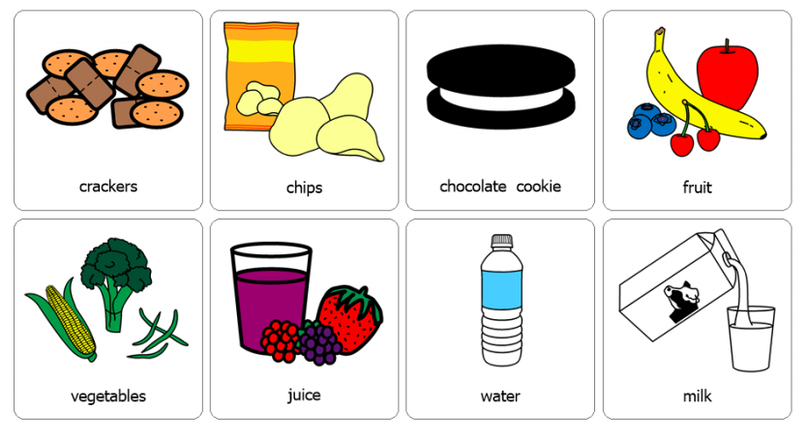
Here are some visuals that may help!

